Slide 1
Subscribe to DeepL Pro to edit this document.
Visit www.DeepL.com/pro for more information.

Slide 2
INTELLIGENCE AS A SERVICE. SELF-MANAGEMENT OF SERVICES
Intelligent infrastructure design for the IoT (DII)
(Part One)
Alfonso González Briones
Based on material created by Jorge Gómez Sanz

Slide 3
Introduction to the subject
Remote Procedure Call
Introduction SaaS and Serverless
Introduction PaaS and IaaS

Slide 4
Remote Procedure Call
REST or WS
Makes a difference
Hamad, H., Saad, M., & Abed, R. (2010). Performance Evaluation of RESTful Web Services for Mobile Devices. Int. Arab J. e-Technol., 1(3), 72-78.
Service response time (milliseconds) and message size (bytes) of the concatenation string.

Slide 5
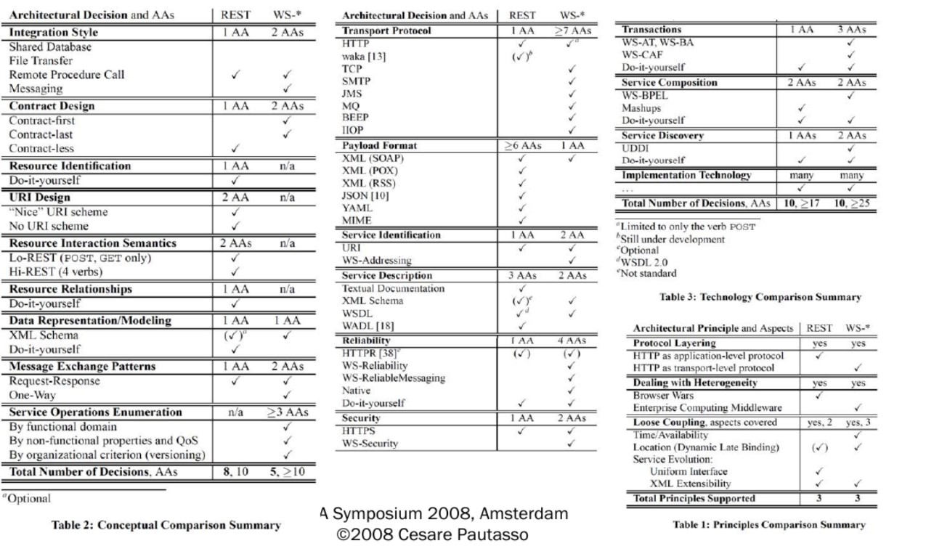
Remote Procedure Call
A Complex Decision - Decision Overview

Slide 6
Remote Procedure Call
So far, they have seen web services and multi-tier architecture, and microservices.
RPC implies that one program calls another program on another machine:
asynchronous
synchronous
It is different from a remote socket invocation in that sockets offer only two operations: read and write.
RPC makes it possible to provide a remote API. Google RPC is an implementation of this approach.
There are others, such as Java RMI or Apache Thrift https://thrift.apache.org/.

Slide 7
Remote Procedure Call
Questions that arise...
Do both programs have to be written in the same language ==> polyglot
What does the other program do when it is not invoked?
What happens if two or more computers want to invoke the program

Slide 8
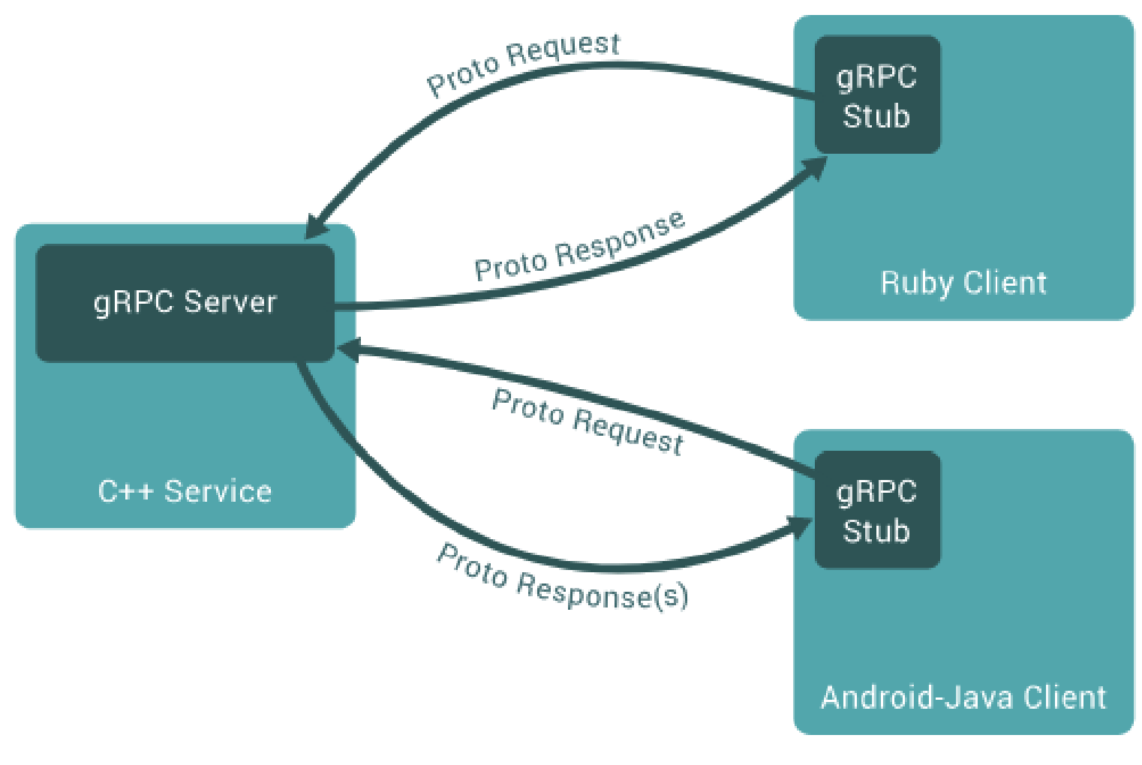
Remote Procedure Call
Google RPC
A description of RPC elements

Slide 9
Remote Procedure Call
Google RPC & IoT
The main reason for integration is the relationship between backend and edge computing. Efficiency
ESP8266 Programming
But you can't directly use gRPC on an arduino!!!!
However, it can handle data streams: https://www.youtube.com/watch?v=c9z_o5lu0dI
gRPC - http://grpc.io
Efficient IoT with the ESP8266, Protocol Buffers, Grafana, Go, and Kubernetes - https://medium.com/grpc/efficient-iot-with-the-esp8266-protocol-buffers-grafana-go-and-kubernetes-a2ae214dbd29

Slide 10
Remote Procedure Call
gRPC Vs WS
SOA also offers us an API / gRPC
WS requires a heavy infrastructure (JBoss, Tomcat) / gRPC does not.
WS may define the protocol / gRPC may not
WS can globally organize how different services are coordinated / gRPC cannot.
WS cannot give uniform data types across the /gRPC infrastructure.
Interesting new ideas: bidirectional streaming in gRPC
A summary of why REST "sucks" when compared to gRPC: https://www.youtube.com/watch?v=RoXT_Rkg8LA

Slide 11
Remote Procedure Call
Benchmark REST Vs gRPC
Workload performance:
Normal loading: REST > gRPC => string concatenation
Heavy load: REST < gRPC => small numbers, big numbers, small and big sentences (??)
Each language has a different performance:

Slide 12
Remote Procedure Call
gRPC IoT
Benchmark (Research Gate):
shorturl.at/mIPR4
More Works (google Scholar):
shorturl.at/ftKP8

Slide 13
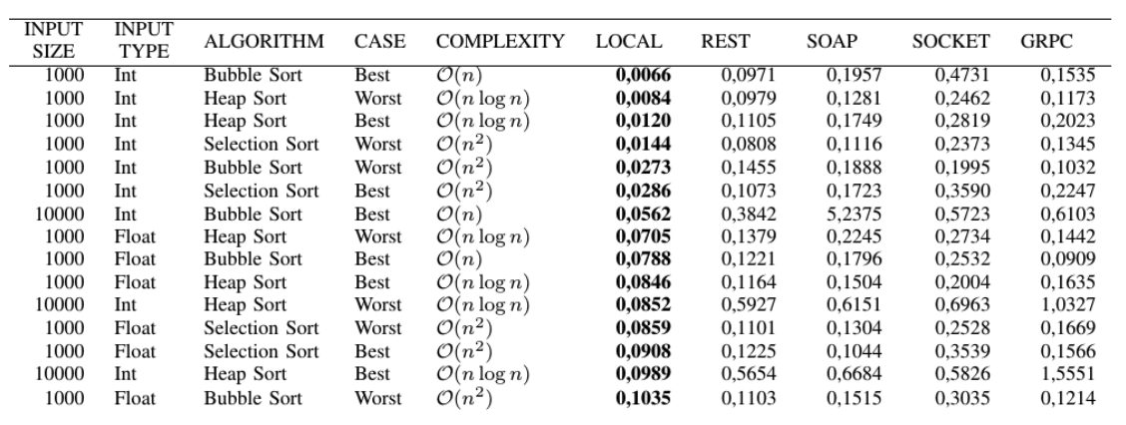
Remote Procedure Call
gRPC IoT - energy consumption (client side)
LocaL: a smartphone Samsung S5 (ARM 2.1Gz Octacore)
Remote: a windows 7 server (Intel Core 2 Duo 2.2Ghz)
- Small vectors
Chamas, C. L., Cordeiro, D., & Eler, M. M. (2017, November). Comparing REST, SOAP, Socket and gRPC in computation offloading of mobile applications: An energy cost analysis. In Communications (LATINCOM), 2017 IEEE 9th Latin-American Conference on (pp. 1-6). IEEE.

Slide 14
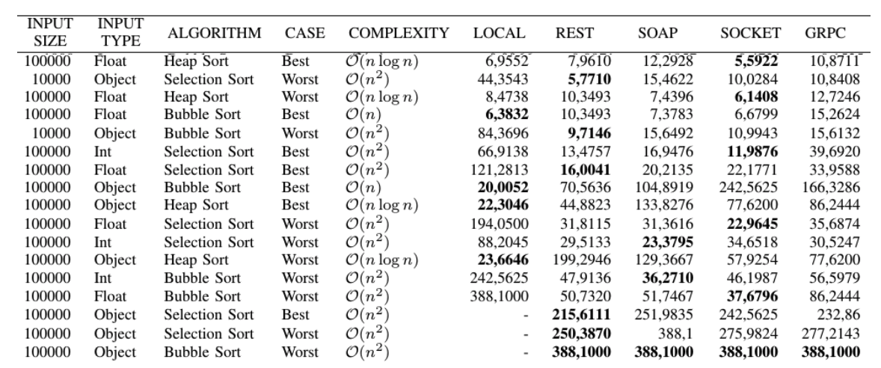
Remote Procedure Call
gRPC IoT - energy consumption (client side)
LocaL: a smartphone Samsung S5 (ARM 2.1Gz Octacore)
Remote: a windows 7 server (Intel Core 2 Duo 2.2Ghz)
- Large vectors
Chamas, C. L., Cordeiro, D., & Eler, M. M. (2017, November). Comparing REST, SOAP, Socket and gRPC in computation offloading of mobile applications: An energy cost analysis. In Communications (LATINCOM), 2017 IEEE 9th Latin-American Conference on (pp. 1-6). IEEE.

Slide 15
Remote Procedure Call
To experience
Clone: https://github.com/escalope/examplegrpc
Execute the following instructions. First example of a simple client server.
$ mvn verify
$ # Run the server in one terminal
$ mvn exec:java -Dexec.mainClass=io.grpc.examples.helloworld.HelloWorldServer
$ # In another terminal run the client
$ mvn exec:java -Dexec.mainClass=io.grpc.examples.helloworld.HelloWorldClient
Now a streaming client to the server:
$ mvn verify
$ # Run the server in one terminal
$ mvn exec:java -Dexec.mainClass=io.grpc.examples.manualflowcontrol.ManualFlowControlServer
$ # In another terminal run the client
$ mvn exec:java -Dexec.mainClass=io.grpc.examples.manualflowcontrol.ManualFlowControlClient

Slide 16
Remote Procedure Call
Conclusions
Integration between the different languages is possible.
WS/RPC/REST are not the fastest/productive ones either.
RPC requirements vs. WS requirements vs. REST requirements
RPC: needs a daemon (a light one) WS: needs an application server (heavy)
REst: need a light server

